Slide 1

BSRA
Presents
Smart Health Solutions

Slide 2


BSRA
Technical Consultant & Services
Vision Statement
“Our vision is to provide innovative technical solutions and consultation to empower businesses and organizations while maintaining efficiency, trust, integrity, cost-effectiveness and customer satisfaction.”

Slide 3

ABOUT OUR COMPANY
BSRA Technical Consultancy services formed to provide enterprise solutions and consultancy in IT, Communication and Healthcare sectors.
BSRA is a firm which combines experienced senior leaders with rich and diverse domain expertise in several domains.
The combined experience of our senior leaders enables us to perceive customer’s business requirements, culture and vision and allow us to accordingly offer customer oriented highly reliable solutions.
Our integrated value-added solution offerings are highly cost effective and state of art.

Slide 4

Advantage with BSRA
BSRA
Technical Consultant & Services
Technology
Time
Our endeavour is to ensure we provide our customers with the latest technology and business processes to provide state-of-the-art solutions
  We aim to deliver well researched and time bound services and solutions as per the customer/project timelines and milestones
BEST OPTION
Security
Cost
Your data security is BSRA’s priority. Our anti-theft and anti-data-loss strategies follow the best security practices to ensure that your data is always safe
  Our services are designed with cost-effectiveness as our priority while keeping our operational costs optimized to align with our client’s budget.

Slide 5








Components of
Smart Health Solutions
Aadhar Integrated Electronic Health Records
Telemedicine Solutions
Remote Emergency Services
Online Appointment Booking
Connected Hospitals

Slide 6

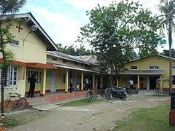

Connected Hospitals
We help enable connecting various diagnostic centres to FRUs and Government General Hospitals through Video conferencing and patient management systems.

Slide 7





Aadhar Integration with Electronic
Health Record
Doctor Reports
Doctor Reports
Lab Reports
Electronic Health Record
Hospital
Integrated patient health record
Ease of sharing information between doctors, insurers etc.
Paperless patient History
Readily available information to enable quick and correct diagnosis and treatment
Scan Reports
Insurers

Slide 8
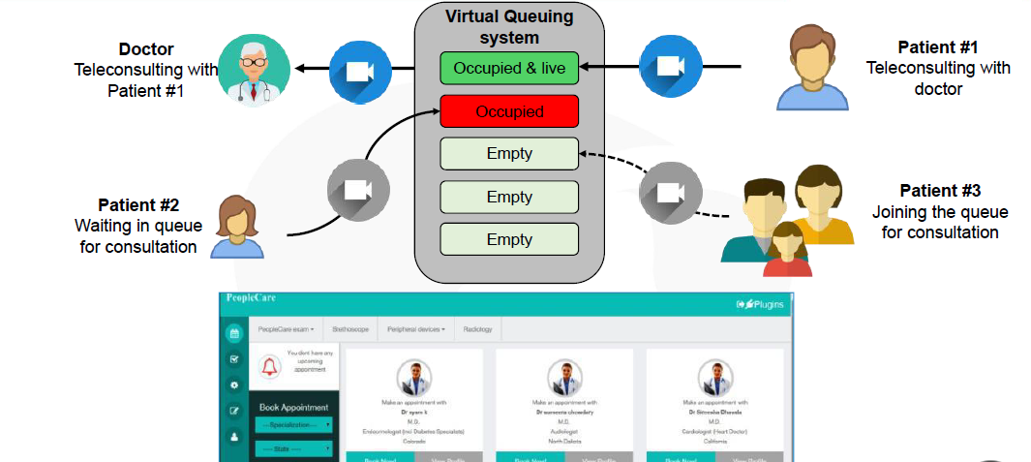
Online Appointment Booking

Slide 9
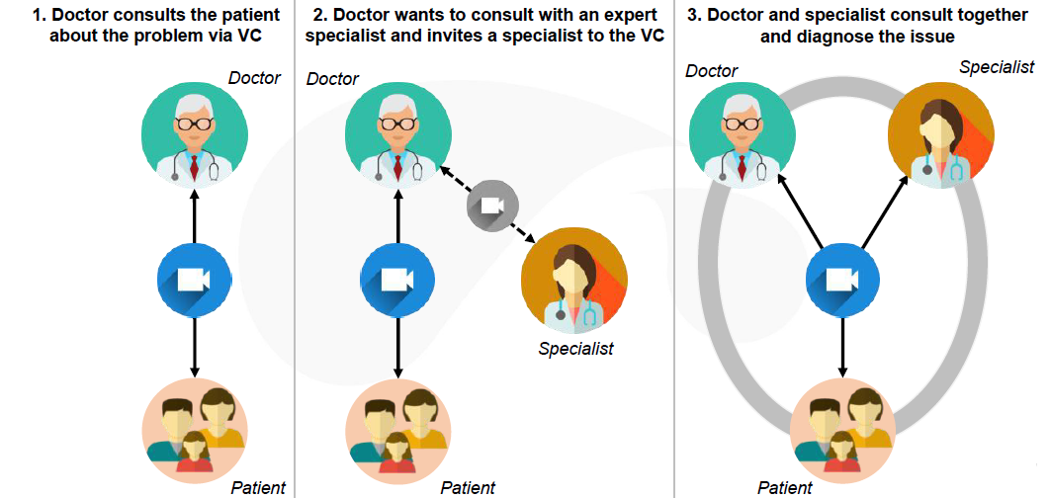
Telemedicine Solution – Online
Teleconsultation
Home Care & remote patient monitoring
Virtual consultations and medical report sharing
Monitor progress of foreign patients after treatment, viewing of latest reports, exchange opinion on diagnosis with their local specialists and post operative care

Slide 10
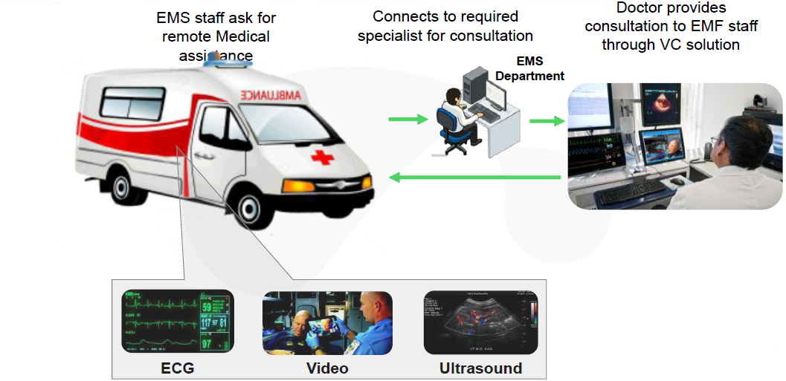
Remote Medical Emergency
Services
Uninterrupted clear-cut view of the patient
Have an expert monitor the patient’s condition and supervise ambulatory care from the first minute
Make necessary preparations for the patient at the Hospital in advance

Slide 11
Contact us
Call Us +91 9910381041
+91 8884899914
Write to us @ sales@bsratech.com
bsra.technology@gmail.com
LinkedIn https://www.linkedin.com/in/bsra-technical-consultancy-and-services-llp-1071651ba/
Website https://www.bsratech.com

